Slide 1

Lecture 6
Forms
Notes:
Welcome to this M1 in SQL Course. In this first chapter of the course, we are going to do an introduction of databases and relational databases.

Slide 2

A G E N D A
Form Input Types
Form Input Attributes
Select & Text Area

Slide 3
Forms Input Types
Notes:
Without further adieu, Let’s look at the course introduction so that you will know what you are going to learn.

Slide 4


Forms
Nowadays it is extremely difficult to find websites that do not include some type of form element
Forms are HTML elements which are used for user input. They can range from text fields where we write our username/passwords or select boxes where we choose our country, occupation.
There are numerous types of form elements, each suited for different purposes

Slide 5

Forms
Form Elements
The most common type of form element is the <input> tag, for allowing users to type in their input.
The <label> tag is a text label to describe the input, so the users know what to type in.
When we fill up forms on the internet, we usually have a submit button. Forms can also define their own submit buttons.

Slide 6

Form Input Types
The <input> tag defines all types of input elements.
The type of input element is defined by the “type” attribute.
<label for="name">First Name</label>
<input type="text" id="name">
The “for” attribute in label matches the “id” of the input.
This is to bind the label and the input element together.
Text Input

Slide 7

Form Input Types
<label for="pwd">Password</label>
<input type="password" id="pwd">
Allows us to create password inputs
Password Input

Slide 8
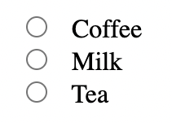
Form Input Types
<input type="radio" id="coffee" name="drink">
<label for="coffee">Coffee</label>
<input type="radio" id="milk" name="drink">
<label for="milk">Milk</label>
<input type="radio" id="tea" name="drink">
<label for="tea">Tea</label>
Radio buttons allow users select ONLY ONE option from the list of choices.
Radio Buttons

Slide 9
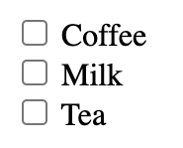
Form Input Types
<input type="checkbox" id="coffee">
<label for="coffee">Coffee</label>
<input type="checkbox" id="milk">
<label for="milk">Milk</label>
<input type="checkbox" id="tea">
<label for="tea">Tea</label>
Checkboxes allow users select MULTIPLE options from the list of choices.
Checkbox

Slide 10
Forms Input Attributes
Notes:
Without further adieu, Let’s look at the course introduction so that you will know what you are going to learn.

Slide 11

Form Input Attributes
Input fields may have several attributes to enhance their functionality
<label for="name">First Name</label>
<input type="text" id="name" value="John">
The input value specifies an initial value for the input field.
Text Input : value

Slide 12
Form Input Attributes
<label for="name">First Name</label>
<input type="text" id="name" value="John" readonly>
Readonly fields cannot be edited or changed by the user.
Text Input : readonly

Slide 13
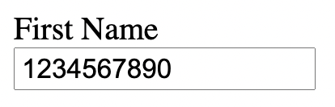
Form Input Attributes
<label for="name">First Name</label>
<input type="text" id="name" value="1234567890" maxlength="10">
Maxlength sets the size of the input field.
We cannot input more than 10 characters in this instance.
Text Input : maxlength

Slide 14
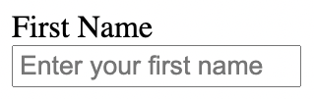
Form Input Attributes
<label for="name">First Name</label>
<input type="text" id="name"
placeholder="Enter your first name">
The input placeholder attribute specifies a short hint
that describes the expected value of an input field.
Text Input : placeholder

Slide 15
Select & Text Area
Notes:
Without further adieu, Let’s look at the course introduction so that you will know what you are going to learn.

Slide 16
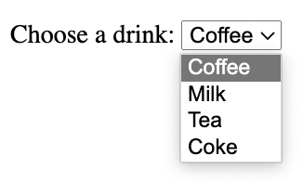
Other Form Elements
<label for="name">Choose a drink</label>
<select id="name">
<option value="coffee">Coffee</option>
<option value="milk">Milk</option>
<option value="tea">Tea</option>
<option value="coke">Coke</option>
</select>
The <label> tag is asking the user a question.
The <option> tag defines the options that can be selected. The first one is auto-selected by default
<select>
This tag allows us to create a dropdown list to choose from

Slide 17
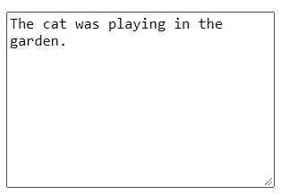
Other Form Elements
<textarea rows="10" cols="30">
The cat was playing in the garden.
</textarea>
The rows attribute specifies the visible number of lines in a text area.
The cols attribute specifies the visible width of a text area.
<textarea>
This tag allows us to create a multi-line input field.
We usually use this for comments or reviews.

Slide 18

That’s all for this module!
THANK YOU!

